Slide 1


esk.AI
Shell.AI
Hackathon For Sustainable And Affordable Energy: AI Solar Power Prediction Challenge
Ricardo Lara, The University of Texas at Austin
Roderick Perez, University of Vienna

Slide 2
Methodology
esk.AI
Dataset details
Explain details of existing dataset and if any other dataset was used for training the network apart from one provided by host:
The dataset consist of 527,040 rows corresponding to 15 variables (Global CMP22 (vent/cor) [W/m^2, Direct sNIP [W/m^2], Azimuth Angle [degrees], Tower Dry Bulb Temp [deg C], Tower Wet Bulb Temp [deg C], Tower Dew Point Temp [deg C], Tower RH [%], Total Cloud Cover [%], Peak Wind Speed @ 6ft [m/s], Avg Wind Direction @ 6ft [deg from N], Station Pressure [mBar], Precipitation (Accumulated) [mm], Snow Depth [cm], Moisture, and Albedo (CMP11)), measured at 1 min interval during 365 days.
Additionally, sky images acquired in 5 min intervals.
No other dataset was used to train the network
Clearly mention the license of any dataset that was used from open source
We didn’t used any extra dataset

Slide 3
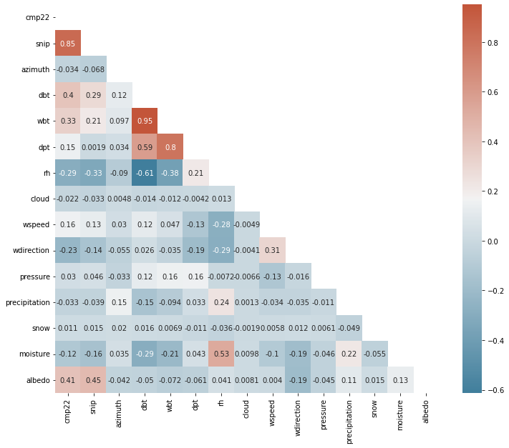
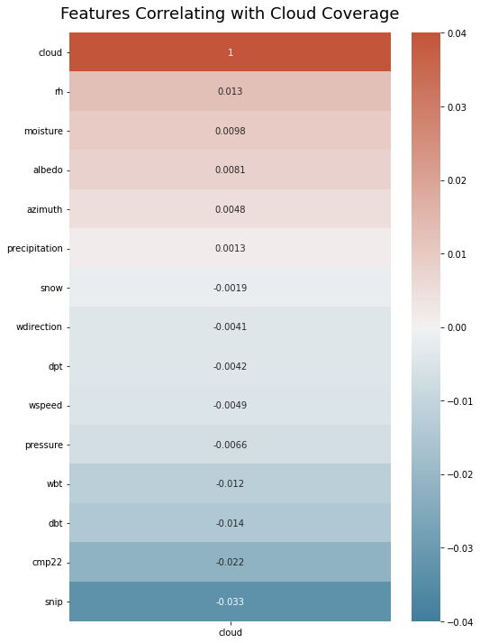
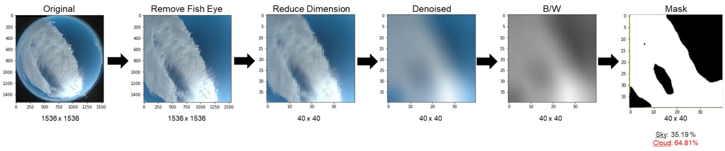
Methodology
esk.AI
Dataset details
Did it require to add any pre-processing to dataset?
We performed Exploration Data Analysis (EDA), calculating a correlation heat map, feature selection and outlier detection.
In case of the image data, the following image summarize the pre-processing stage:

Slide 4

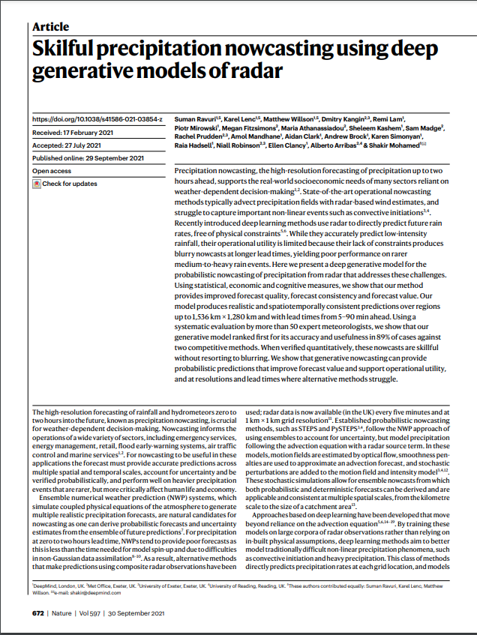
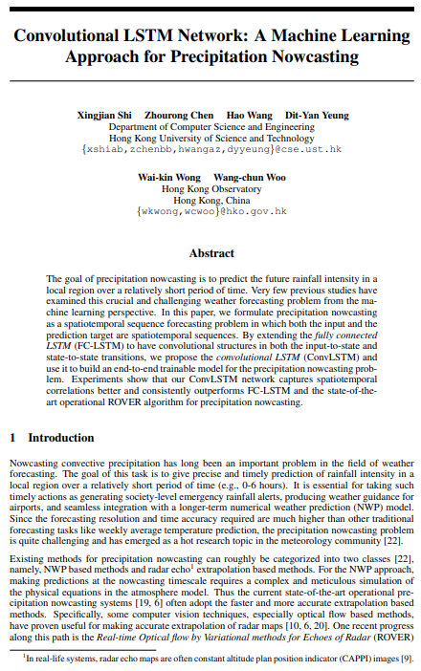
Methodology
esk.AI
Existing / Pre-Existing Work
Any similar work you encountered and took motivation from in the literature
Solar Energy Forecasting and Resource Assessment
Jan Kleissi
Skilful precipitation nowcasting using deep generative models of radar
Ravuri, et al. 2021
Nature volume 597, pages672–677 (2021)
Convolutional LSTM Network: A Machine Learning Approach for Precipitation Nowcasting
Shi, et al. 2015
arXiv:1506.04214

Slide 5
Methodology
esk.AI
Experiment Results
Model details
Did you use pre-existing model or customized it for the submission? No
Did you use any transfer learning ? No
Performance details
What did you change to improve Performance of training the network?
Feature selection
Hyperparameter tunning

Slide 6
Final Solution
esk.AI
Hardware used for Stage 1
Did you use or any accelerators for same? Did you use your own desktop/cloud/cluster for the Stage 1?
We used GPU from Google Colab Pro
Software packages used for Stage 1
Which all framework and libraries were used to get to solution?
Pandas
Matplotlib
Numpy
Seaborn
PIL
cv2
Defisheye
tensorflow

Slide 7
Final Solution
esk.AI
Performance Numbers: ( GPU/CPU Details )
Training Times : How much total hours were spent on training to get the final best score?
Using GPU we were able to train the solution in less than 24 hours
License:
Is the solution available Open Source or Closed ?
Open Source
What is the license of Solution?
MIT

